Slide 1
Modifying Specific Layout Properties
Notes:
Schedule: Timing Topic
<xx> minutes Lecture
<xx> minutes Practice
<xx> minutes Total

Slide 2
Objectives
  After completing this lesson, you should be able to
do the following:
  Identify specific layout properties
  Modify specific layout properties
  Explain the use of specific properties
  Create a file link
Notes:
Lesson Aim
<Enter lesson aim here.>

Slide 3
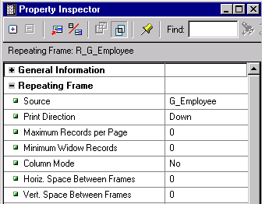
Properties of a Repeating Frame

Slide 4
Print Direction
1
2
3

Slide 5
Records per Page
1
2
-1-
-1-
-2-
-3-
-2-

Slide 6
Spacing Between Records
Mailing Labels
1
2

Slide 7

Minimum Widow Records
Without widow control
Page 1
Page 2

Slide 8
Minimum Widow Records
Without widow control
With widow control
(Min Widow Records = 3)
Page 1
Page 2
Page 1
Page 2

Slide 9
Column Mode
Column Mode Off
Page 1
10 20
Page 2
20 30

Slide 10
Column Mode
Column Mode Off
Column Mode On
Page 1
10 20
Page 2
20 30
Page 1
10 20 30
Page 2
20

Slide 11
Properties of a Field
  Fields define formatting attributes and logic
  Wizard creates a field for each column
  You create additional fields in the Paper Layout:
    Source: Column, parameter, or system variable
    Format mask: Standard Oracle format symbols

Slide 12
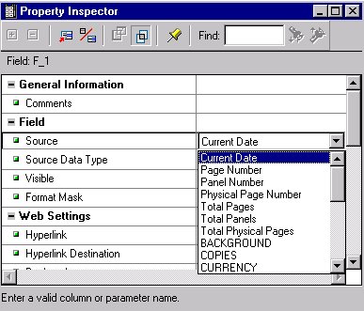
System Variables

Slide 13
Page Numbering
Page 4 of 4
End
Example 1
Page 3 of 4
Page 2 of 4
Page 1 of 4
Example 2
Report
Title
End
Page 1 of 1
Page 2 of 2
Page 1 of 2
Report
Title

Slide 14
Valid Source Columns
G_Region
R_Region
R_Dept
R_Emp
G_Dept
F_1
G_Emp
F_REPORT

Slide 15

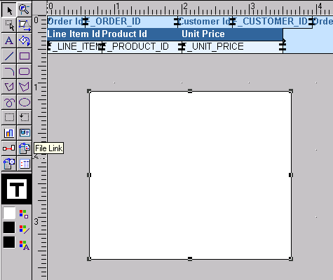

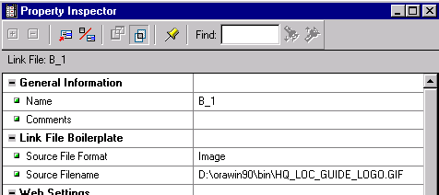
Displaying File Contents

Slide 16
When Are Contents Updated?
Reports Builder reads the file contents when you:
  Modify the Property Inspector
  Open a report definition
  Run a report

Slide 17


Linking and Importing Files
1

Slide 18
Linking and Importing Files
1
2
Import
Link

Slide 19

Linking and Importing Files
1
2
Import
Link
3

Slide 20
Linking and Importing Files
1
2
Import
Link
3
4

Slide 21
Comparing a File Link and a File Column
Q_EMP
G_EMP
PICTURE
F_PICTURE
1
2

Slide 22
Summary
  In this lesson, you should have learned how to:
  Identify object-specific properties
  Modify these properties when necessary
  Create a file link in your report

Slide 23
Practice 13 Overview
  Modifying the printing of a mailing label report
  Controlling the number of records on a page
  Adding a file link to a report
  Ensuring all details of a master print on the same page

